Slide 1
Increased temperatures shift flower height distributions and seed dispersal patterns in invasive thistles
Trevor Drees
The Pennsylvania State University
thd5066@psu.edu

Slide 2
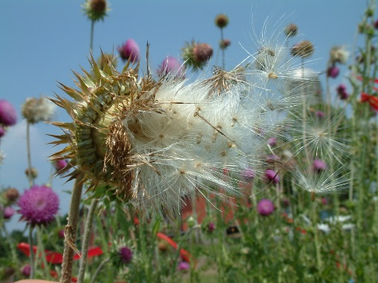
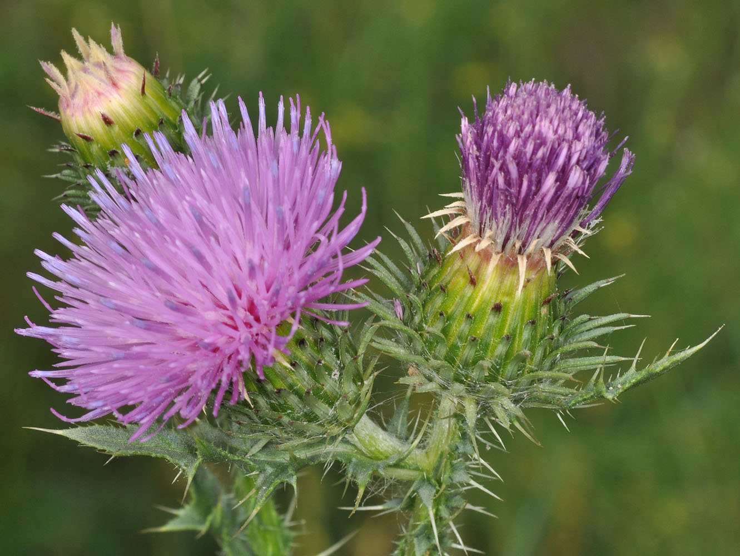
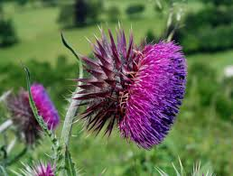
Background & Introduction
Background & Introduction
Study System & Methods
Image source: O. Skarpaas
Results
Discussion & Conclusions
Image source: brc.ac.uk
Image source: web.ewu.edu

Slide 3
Background & Introduction
Background & Introduction
Study System & Methods
Image source: O. Skarpaas
Results
Discussion & Conclusions
Image source: brc.ac.uk
Image source: web.ewu.edu

Slide 4
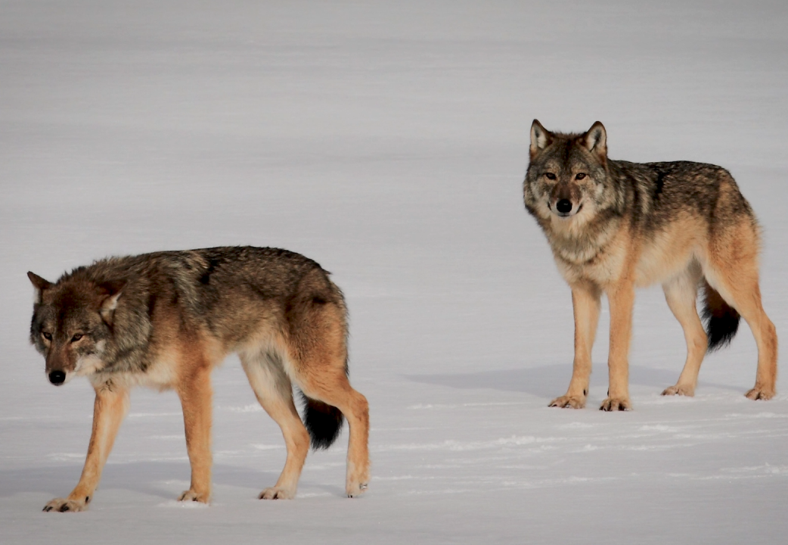
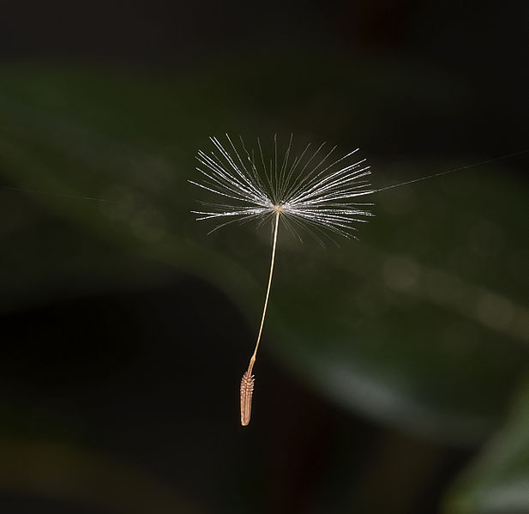
Background & Introduction
What is dispersal?
Image source: pbs.org
Image source: Wikipedia
Any movement of organisms that can possibly generate gene flow.

Slide 5
Background & Introduction
Why quantify dispersal?
We can do a better job of…
Understanding how species distributions shift
Understanding gene flow between populations
Making predictions regarding the spread of invasive species

Slide 6
Background & Introduction
Why quantify dispersal?
We can do a better job of…
… which entails …
Understanding how species distributions shift
Predicting how quickly invasive species spread
Understanding gene flow between populations
Understanding which life stages contribute most to dispersal
Making predictions regarding the spread of invasive species
Understanding which agents most strongly drive dispersal

Slide 7
Background & Introduction
Why quantify dispersal?
We can do a better job of…
… which entails …
Understanding how species distributions shift
Predicting how quickly invasive species spread
Understanding gene flow between populations
Understanding which life stages contribute most to dispersal
Making predictions regarding the spread of invasive species
Understanding which agents most strongly drive dispersal
A better understanding of dispersal in invasive species can help us make more informed management decisions that save time and money

Slide 8
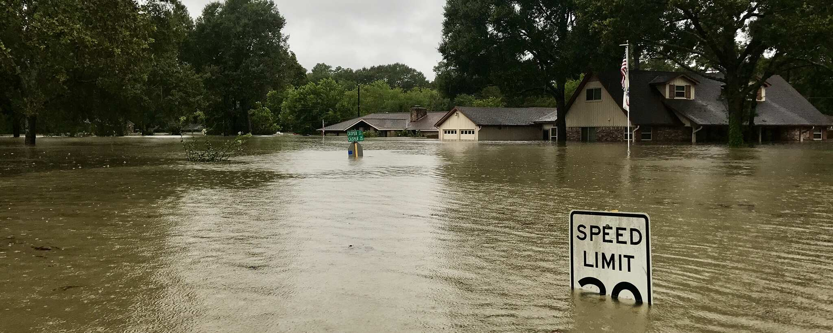
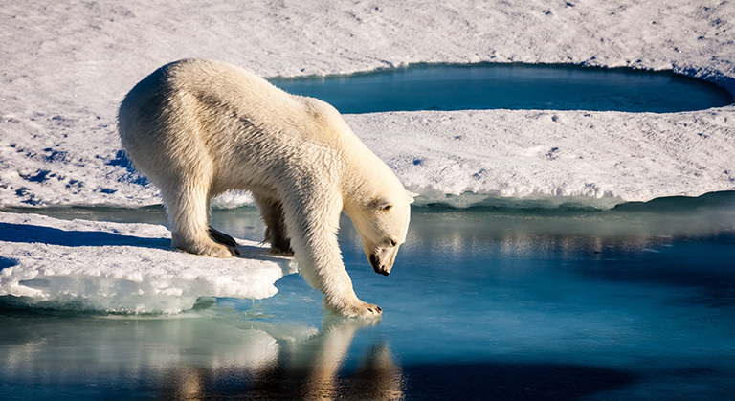
Background & Introduction
Climate change may affect dispersal
Climate change has the potential to affect dispersal of organisms, either by directly affecting dispersal vectors or indirectly by affecting dispersal-related factors.
This includes:
Temperature
Precipitation
Wind speeds
Frequency of extreme events
Image source: ready.gov
Image source: climate.nasa.gov

Slide 9
Background & Introduction
Climate change may affect dispersal
Climate change has the potential to affect dispersal of organisms, either by directly affecting dispersal vectors or indirectly by affecting dispersal-related factors.
This includes:
Temperature
Precipitation
Wind speeds
Frequency of extreme events
Image source: O. Skarpaas
Wind-dispersed invasive species!

Slide 10
Background & Introduction
Climate change may affect dispersal
Climate change has the potential to affect dispersal of organisms, either by directly affecting dispersal vectors or indirectly by affecting dispersal-related factors.
This includes:
Temperature
Precipitation
Wind speeds
Frequency of extreme events
Could affect growth; seeds released higher and travel further
Image source: O. Skarpaas
Wind-dispersed invasive species!

Slide 11
Background & Introduction
Climate change may affect dispersal
Climate change has the potential to affect dispersal of organisms, either by directly affecting dispersal vectors or indirectly by affecting dispersal-related factors.
This includes:
Temperature
Precipitation
Wind speeds
Frequency of extreme events
Faster wind blows seeds further
Image source: O. Skarpaas
Wind-dispersed invasive species!

Slide 12
Background & Introduction
Climate change may affect dispersal
Climate change has the potential to affect dispersal of organisms, either by directly affecting dispersal vectors or indirectly by affecting dispersal-related factors.
This includes:
Temperature
Precipitation
Wind speeds
Frequency of extreme events
Extreme wind events can carry seeds very long distances
Image source: O. Skarpaas
Wind-dispersed invasive species!

Slide 13
Background & Introduction
Climate change may affect dispersal
Climate change has the potential to affect dispersal of organisms, either by directly affecting dispersal vectors or indirectly by affecting dispersal-related factors.
This includes:
Temperature
Precipitation
Wind speeds
Frequency of extreme events
Land managers worry about how this will affect invasive species management… 65% have incorporated climate change into their management plans! (Beaury et al. 2020).
Image source: O. Skarpaas
Wind-dispersed invasive species!

Slide 14
Background & Introduction
Dream big…
Temperature increases
A model including all of these factors would be an extremely useful tool for predicting changes in invasive species dispersal…
Precipitation shifts
Changes in wind speeds
Increased frequency of extreme events

Slide 15
Background & Introduction
Dream big… but start small
Temperature increases
A model including all of these factors would be an extremely useful tool for predicting changes in invasive species dispersal…
… but it would also be quite complicated, and would require a lot of data. Perhaps we should start with something simpler?
Precipitation shifts
Changes in wind speeds
Increased frequency of extreme events

Slide 16
Background & Introduction
Dream big… but start small
Temperature increases
A model including all of these factors would be an extremely useful tool for predicting changes in invasive species dispersal…
… but it would also be quite complicated, and would require a lot of data. Perhaps we should start with something simpler?
We will examine how temperature increases affect invasive plant dispersal and construct the bulk of the model framework necessary to incorporate shifts in other climatic factors.
Precipitation shifts
Changes in wind speeds
Increased frequency of extreme events

Slide 17
Background & Introduction
Research goal
Use empirical data and mechanistic models to predict how increases in temperature will alter dispersal patterns in invasive plant species.
Image source: O. Skarpaas

Slide 18
Background & Introduction
Research goal
Use empirical data and mechanistic models to predict how increases in temperature will alter dispersal patterns in invasive plant species.
Not all species will exhibit the same responses to temperature increases, though.
We need to choose a species to use as a case study…
Image source: O. Skarpaas

Slide 19
Study System & Methods
Background & Introduction
Study System & Methods
Image source: O. Skarpaas
Results
Discussion & Conclusions
Image source: brc.ac.uk
Image source: web.ewu.edu

Slide 20
Study System & Methods
Study system: invasive thistles
Carduus nutans
Carduus acanthoides
Image source: brc.ac.uk
Image source: web.ewu.edu
“musk thistle”, “nodding thistle”
“plumeless thistle”, “spiny plumeless thistle”

Slide 21
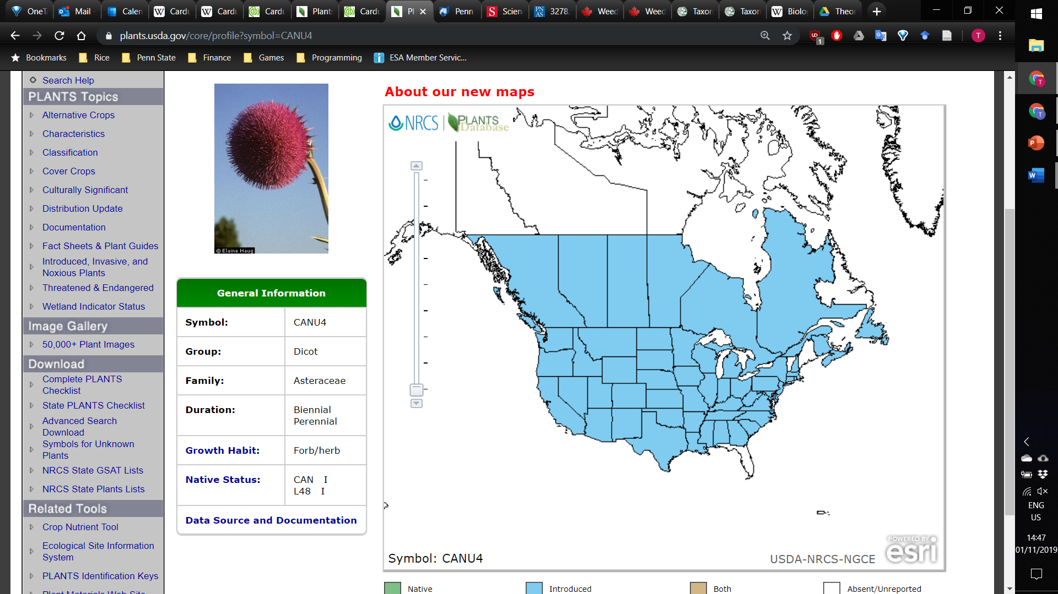
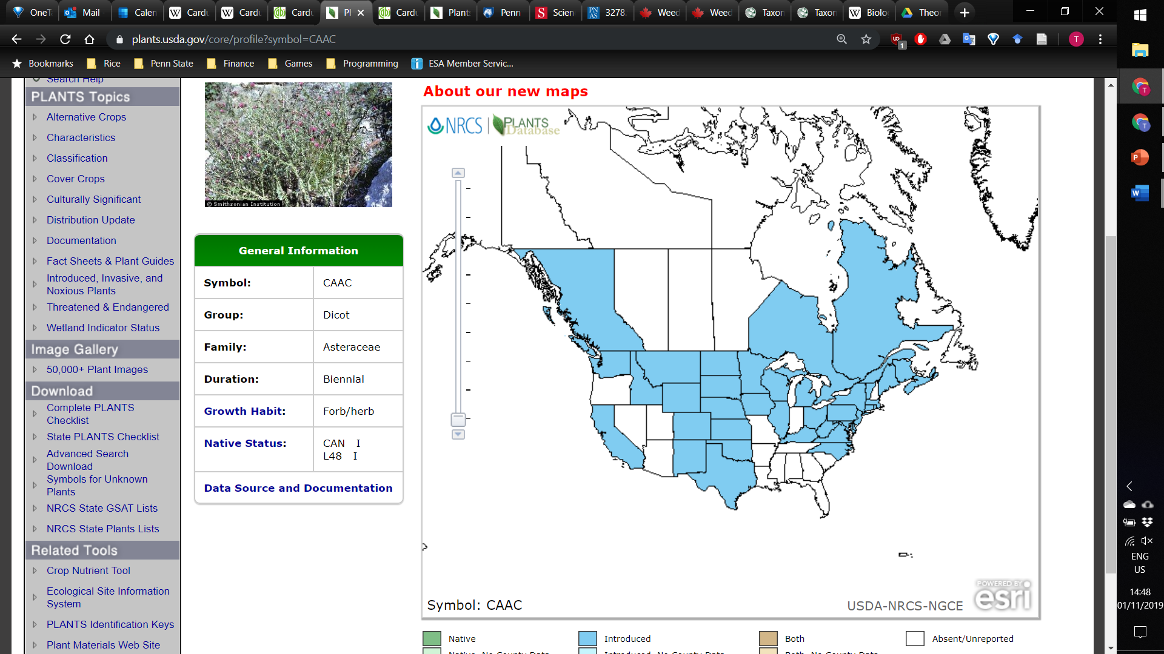
Study System & Methods
Carduus nutans
Carduus acanthoides
Image source: plants.usda.gov
Image source: plants.usda.gov
Introduced
U.S. (All states except AK, FL, HI, ME, VT)
Canada (All provinces except NT, NU, PE, YT)
South America (Chile)
Africa (South Africa)
Australia and New Zealand
Native to Europe and Central Asia
Introduced
U.S. (33 states)
Canada (BC, NB, NS, ON, QC)
South America (Argentina, Uruguay)
Africa (South Africa)
New Zealand
Native to Europe and Central Asia

Slide 22
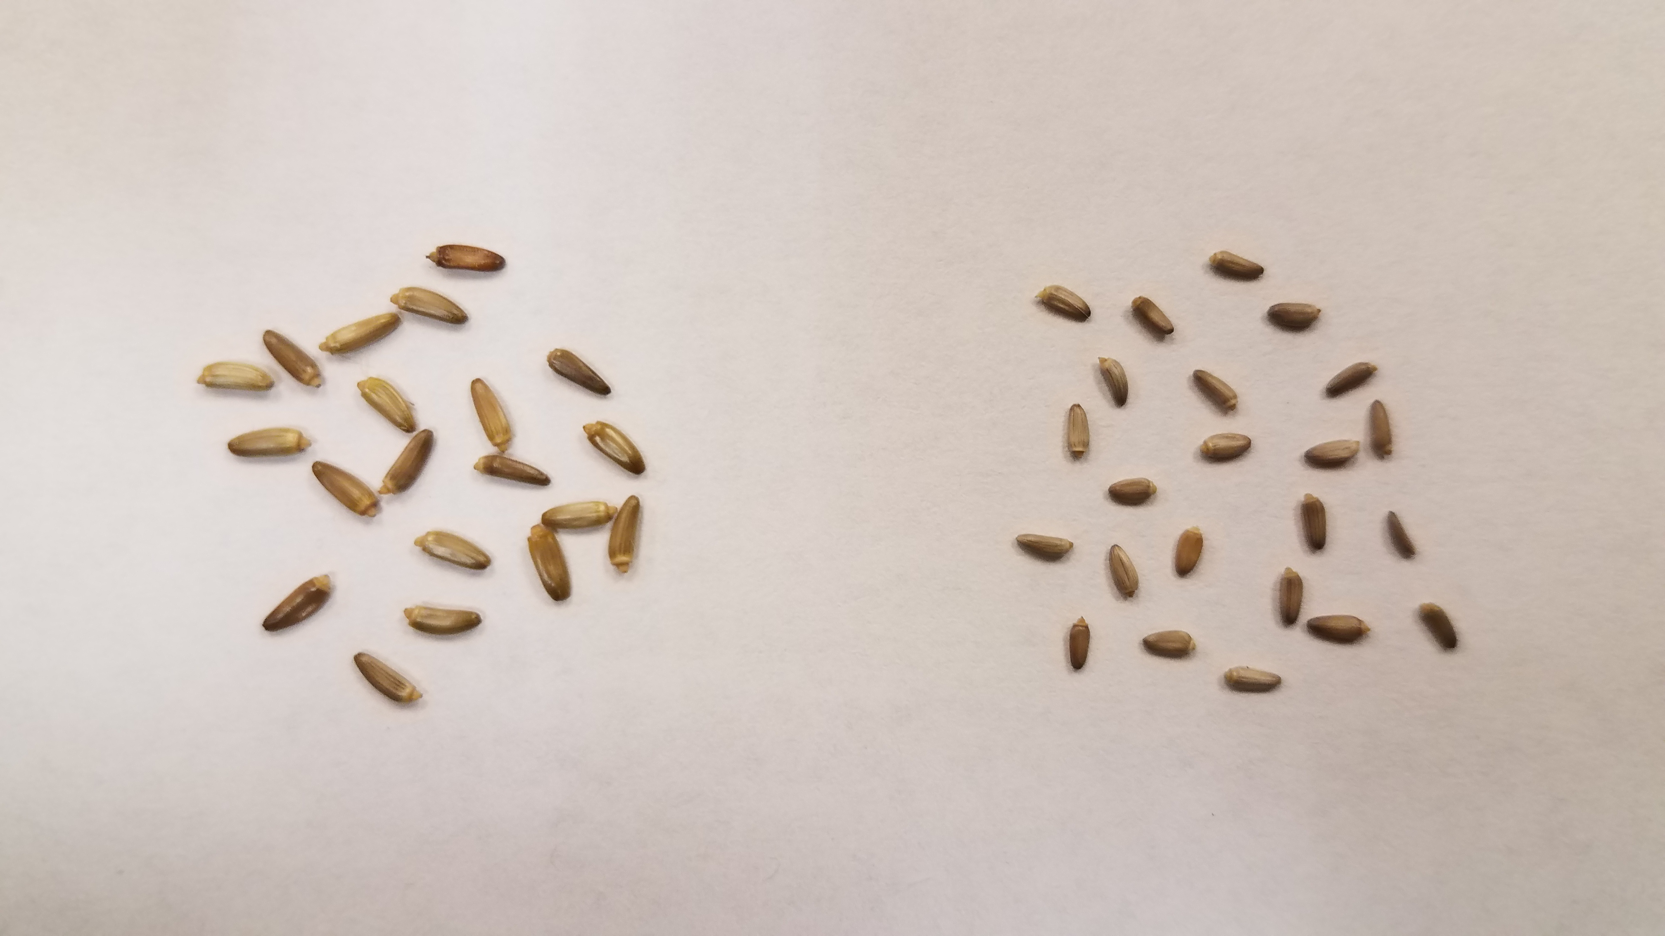
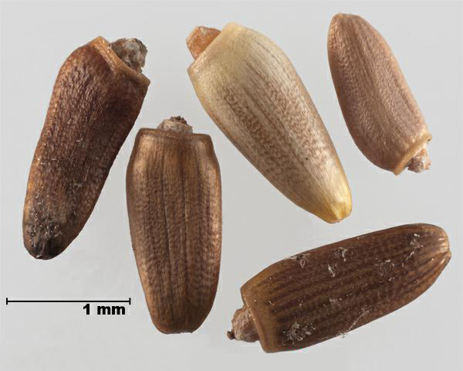
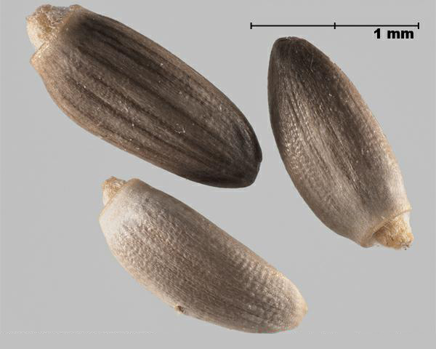
Study System & Methods
Seeds are the propagules through which these thistles are dispersed…
Image source: T. Drees
Carduus nutans Carduus acanthoides
Image source: inspection.gc.ca
Image source: inspection.gc.ca

Slide 23
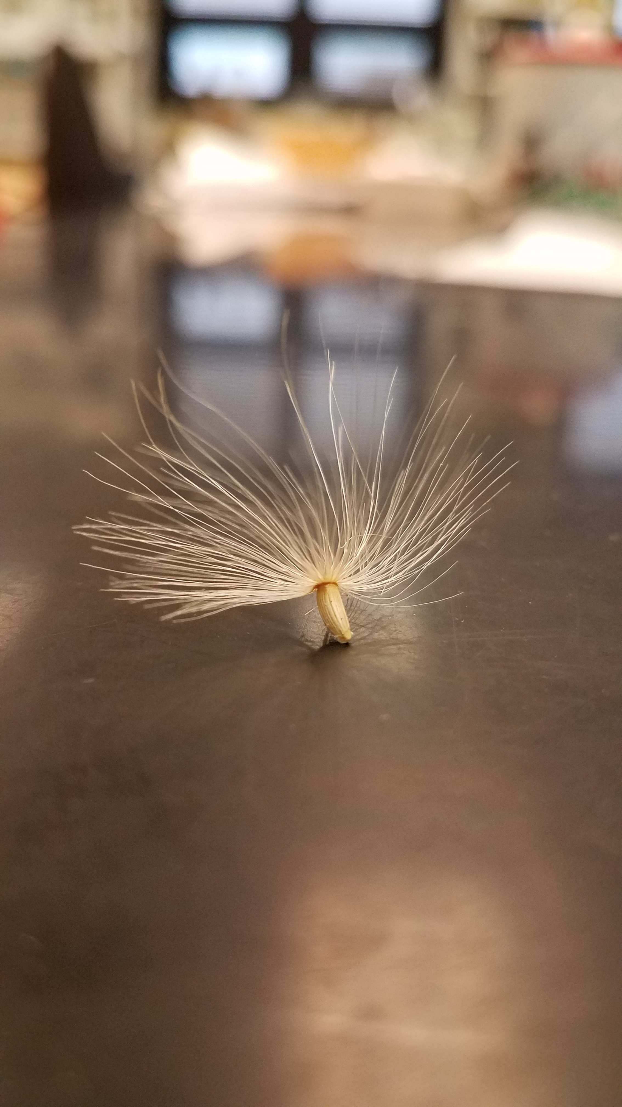
Study System & Methods
… and wind is the primary dispersal mechanism.
Image source: O. Skarpaas
Image source: T. Drees

Slide 24
Study System & Methods
… and wind is the primary dispersal mechanism.
Image source: O. Skarpaas
Image source: T. Drees
But how do we model this dispersal?

Slide 25
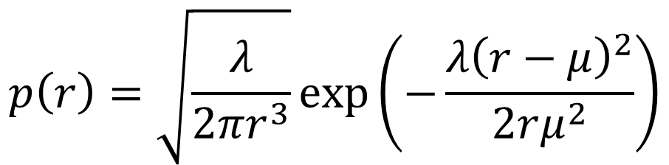
Study System & Methods
Wind dispersal can be simulated using an inverse Gaussian distribution based on a mechanistic fluid dynamics model:
$$p\left(r\right)=\sqrt{\frac{λ}{2πr^{3}}}exp⁡\left(−\frac{λ{\left(r−μ\right)}^{2}}{2rμ^{2}}\right)$$
Katul et al. 2005, Skarpaas and Shea 2007

Slide 26
Study System & Methods
Wind dispersal can be simulated using an inverse Gaussian distribution based on a mechanistic fluid dynamics model:
$$p\left(r\right)=\sqrt{\frac{λ}{2πr^{3}}}exp⁡\left(−\frac{λ{\left(r−μ\right)}^{2}}{2rμ^{2}}\right)$$
Dispersal kernel giving probability density for a seed travelling distance r from release
Katul et al. 2005, Skarpaas and Shea 2007

Slide 27
Study System & Methods
Wind dispersal can be simulated using an inverse Gaussian distribution based on a mechanistic fluid dynamics model:
$$p\left(r\right)=\sqrt{\frac{λ}{2πr^{3}}}exp⁡\left(−\frac{λ{\left(r−μ\right)}^{2}}{2rμ^{2}}\right)$$
Dispersal kernel giving probability density for a seed travelling distance r from release
Scale parameter from:
Mean wind speed
Wind measurement height
Vegetation cover characteristics
Seed release height
Katul et al. 2005, Skarpaas and Shea 2007

Slide 28
Study System & Methods
Wind dispersal can be simulated using an inverse Gaussian distribution based on a mechanistic fluid dynamics model:
$$p\left(r\right)=\sqrt{\frac{λ}{2πr^{3}}}exp⁡\left(−\frac{λ{\left(r−μ\right)}^{2}}{2rμ^{2}}\right)$$
Dispersal kernel giving probability density for a seed travelling distance r from release
Scale parameter from:
Mean wind speed
Wind measurement height
Vegetation cover characteristics
Seed release height
Mean/location parameter from:
Mean wind speed
Seed release height
Seed terminal velocity
Katul et al. 2005, Skarpaas and Shea 2007

Slide 29
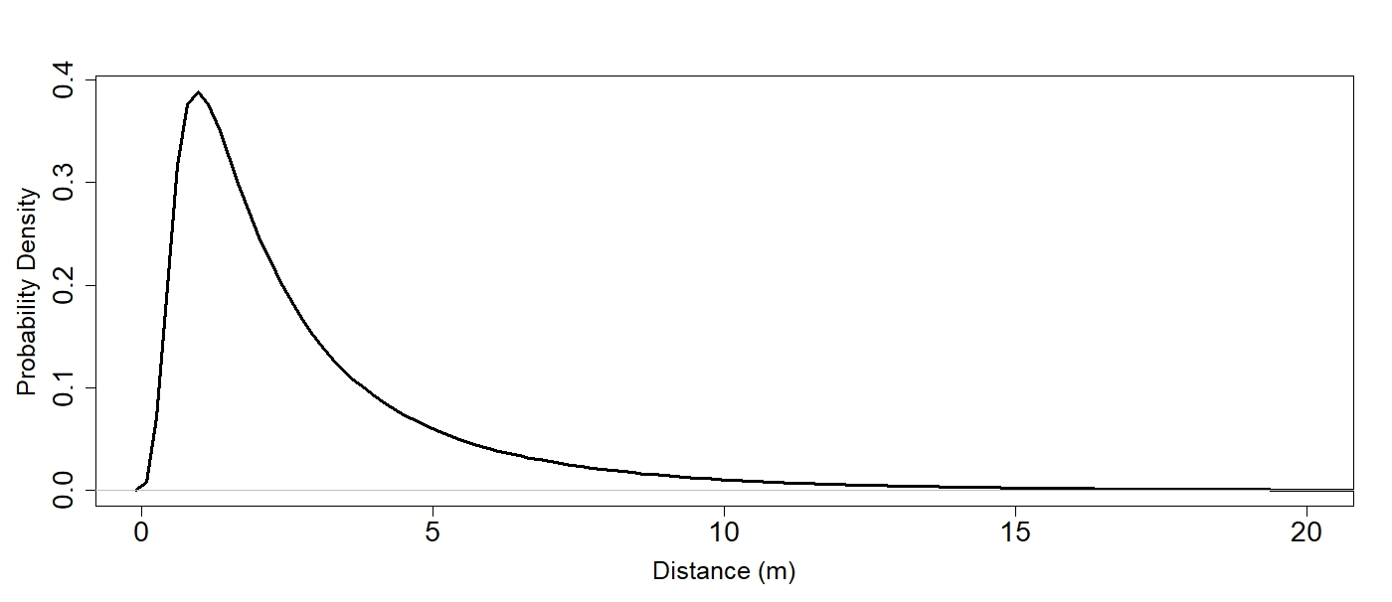
Study System & Methods
This yields a dispersal kernel that shows the likelihood of a propagule travelling a given distance.

Slide 30
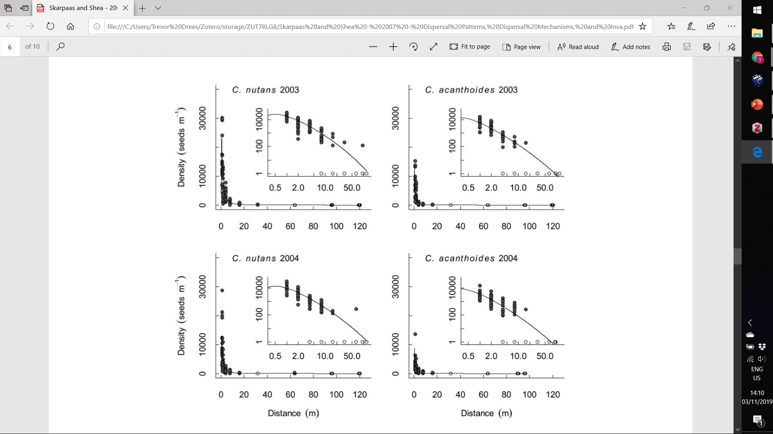
Study System & Methods
This wind dispersal model has been tested in several systems, including in Carduus nutans and Carduus acanthoides, and fits the data well.
Image source: Skarpaas and Shea (2007)

Slide 31
Study System & Methods
This wind dispersal model has been tested in several systems, including in Carduus nutans and Carduus acanthoides, and fits the data well.
Densities of seeds collected using seed traps
Predicted seed density based on mechanistic dispersal model
Image source: Skarpaas and Shea (2007)

Slide 32
Study System & Methods
This wind dispersal model has been tested in several systems, including in Carduus nutans and Carduus acanthoides, and fits the data well.
Densities of seeds collected using seed traps
Predicted seed density based on mechanistic dispersal model
This model outperformed all of the other models that were tested!
Image source: Skarpaas and Shea (2007)

Slide 33

Study System & Methods
Mean wind speed
Mean seed terminal velocity
Height of wind speed measurement
Height of grass cover
Base dispersal kernel
$$p(r)$$

Slide 34
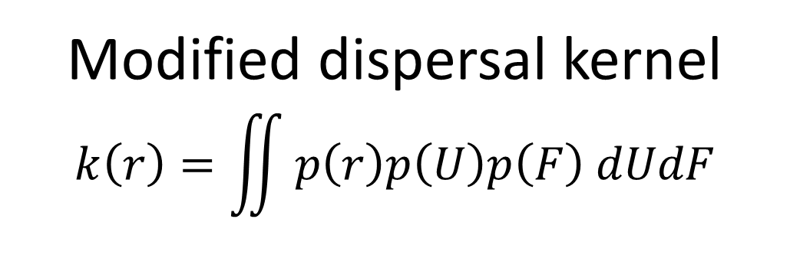
Study System & Methods
Varying wind speeds p(U)
Varying seed terminal velocities
p(F)
Height of wind speed measurement
Height of grass cover
Modified dispersal kernel
$$k\left(r\right)=\iint{p\left(r\right)p\left(U\right)p\left(F\right) dUdF}$$

Slide 35
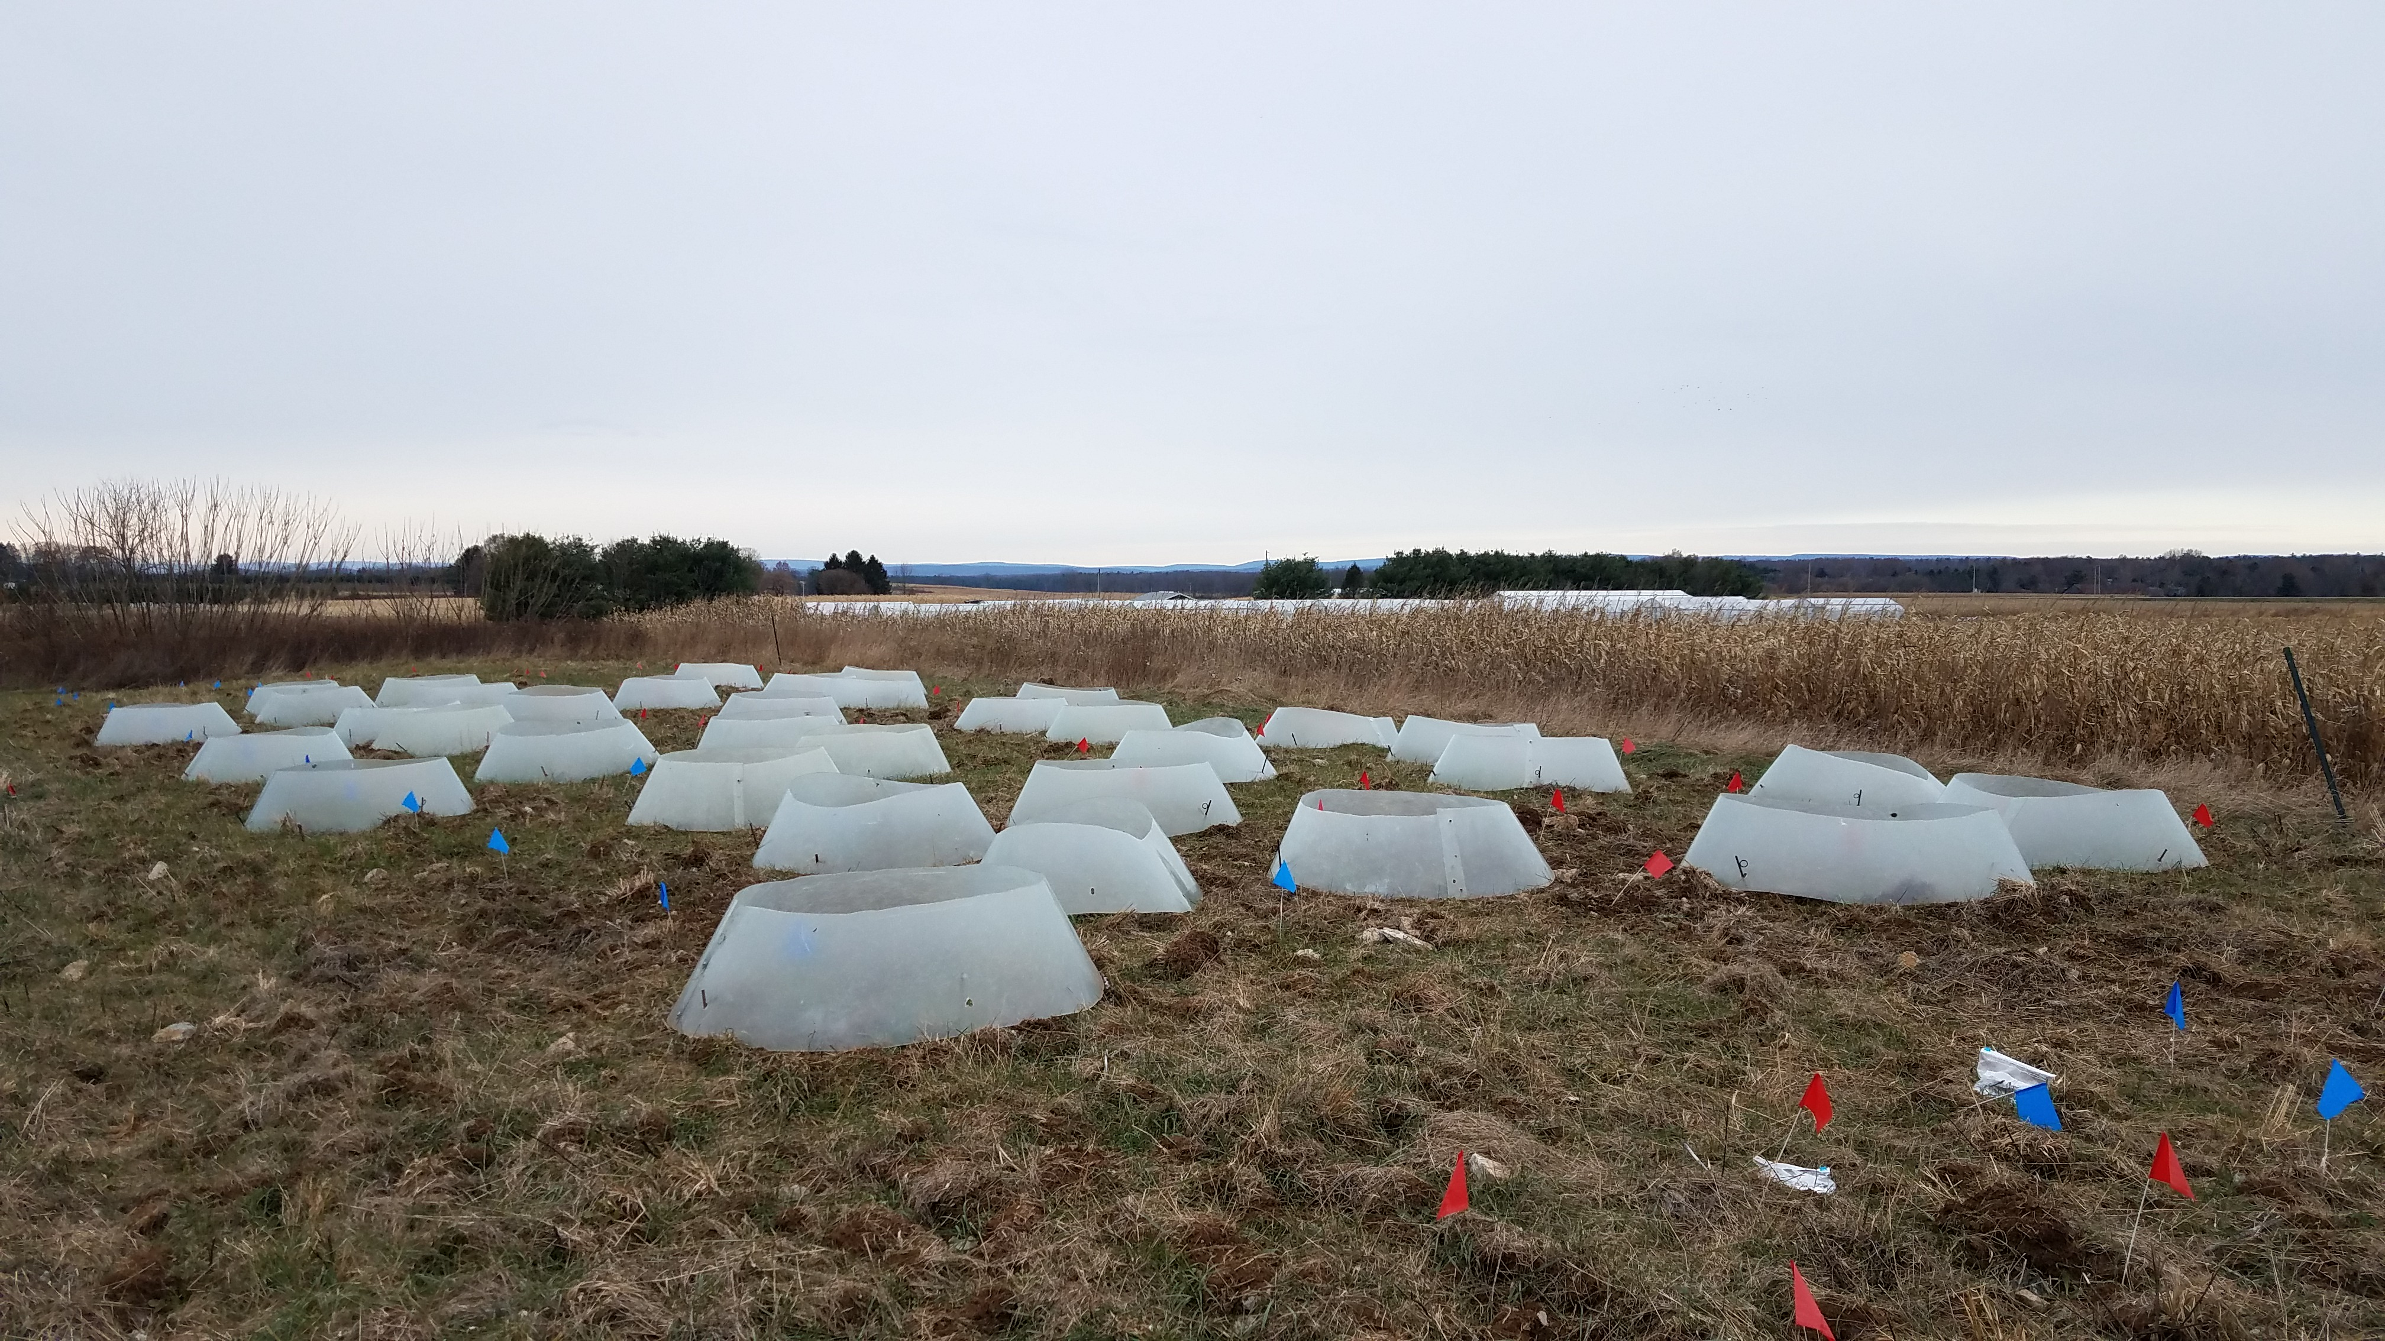
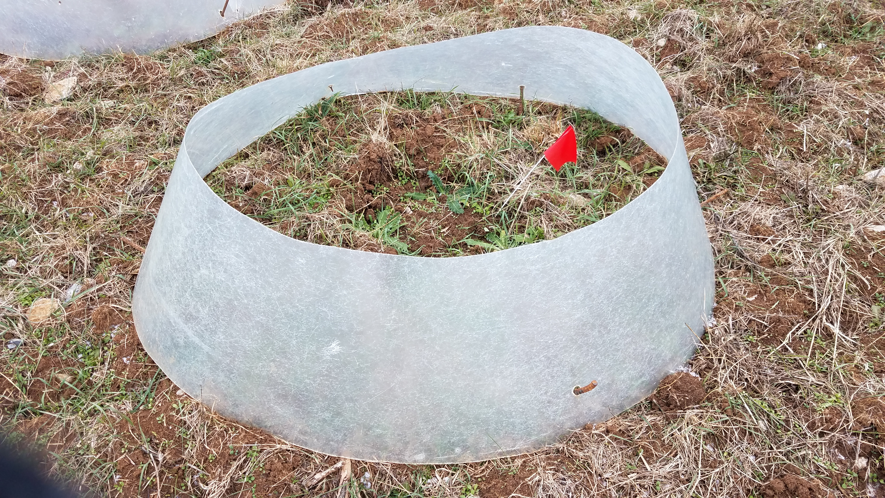
Study System & Methods
We’ve covered how to simulate wind dispersal, but what about warming?
Image source: T. Drees
Image source: T. Drees

Slide 36
Study System & Methods
We’ve covered how to simulate wind dispersal, but what about warming?
For treatment blocks of C. nutans and C. acanthoides, half of the individuals in each block received a fibreglass open-top chamber.
These chambers simulate a 0.58 °C average increase in ambient temperature, and do not affect soil moisture or snow depth (Zhang et al. 2011).
Chambers were places around the thistles in the autumn and remained for the duration of the experiment.
Image source: T. Drees
Image source: T. Drees

Slide 37
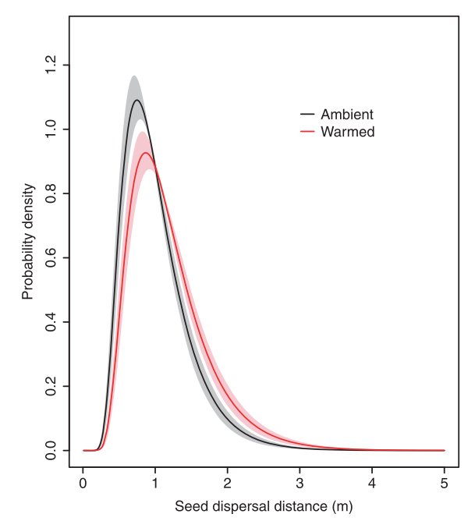
Study System & Methods
Previous studies have shown that, at least in C. nutans, that warming increases mean height and shifts dispersal kernels to the right.
Image source: Zhang et al (2011)

Slide 38
Study System & Methods
Previous studies have shown that, at least in C. nutans, that warming increases mean height and shifts dispersal kernels to the right.
However…
Image source: Zhang et al (2011)

Slide 39
Study System & Methods
Previous studies have shown that, at least in C. nutans, that warming increases mean height and shifts dispersal kernels to the right.
However…
This is not as clear for C. acanthoides.
Also, previous studies have only considered seed release as a single point source at the maximum flower height; what about the other release heights?
Image source: Zhang et al (2011)

Slide 40
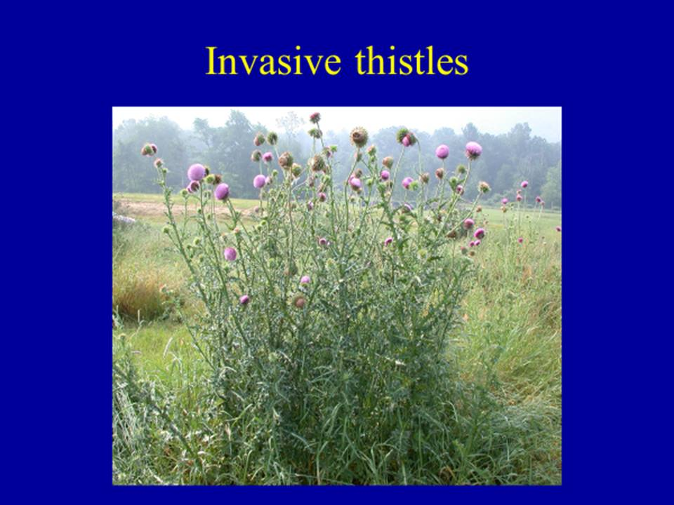
Study System & Methods
Previous studies used the maximum point of seed release (i.e. the highest flower) on each plant to calculate dispersal kernels.
Image source: K. Shea

Slide 41
Study System & Methods
Previous studies used the maximum point of seed release (i.e. the highest flower) on each plant to calculate dispersal kernels.
But seeds release from a variety of different heights on the same plant!
How does the dispersal kernel change when accounting for all seed release heights on an individual?
Image source: K. Shea

Slide 42
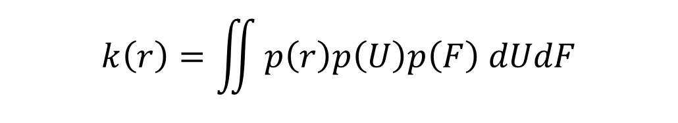
Study System & Methods
Previous studies used the maximum point of seed release (i.e. the highest flower) on each plant to calculate dispersal kernels.
But seeds release from a variety of different heights on the same plant!
How does the dispersal kernel change when accounting for all seed release heights on an individual?
$$k\left(r\right)=\iint{p\left(r\right)p\left(U\right)p\left(F\right) dUdF}$$
Image source: K. Shea

Slide 43
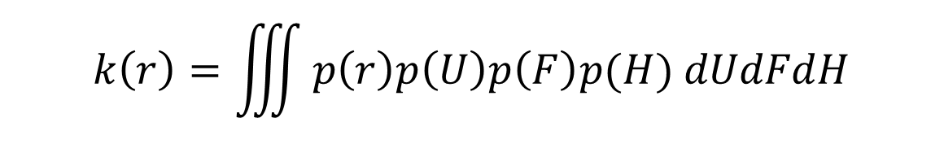
Study System & Methods
Previous studies used the maximum point of seed release (i.e. the highest flower) on each plant to calculate dispersal kernels.
But seeds release from a variety of different heights on the same plant!
How does the dispersal kernel change when accounting for all seed release heights on an individual?
$$k\left(r\right)=\iiint{p\left(r\right)p\left(U\right)p\left(F\right)p(H) dUdFdH}$$
Image source: K. Shea

Slide 44
Study System & Methods
Research questions
How does increased temperature affect the distribution of flower heights (and thus seed release heights)?
How does increased temperature affect dispersal distances over the distribution of flower heights?
Are there differences in dispersal when using the distribution of seed release heights rather than the maximum height?

Slide 45
Results
Background & Introduction
Study System & Methods
Image source: O. Skarpaas
Results
Discussion & Conclusions
Image source: brc.ac.uk
Image source: web.ewu.edu

Slide 46
Results
Research questions
How does increased temperature affect the distribution of flower heights (and thus seed release heights)?
How does increased temperature affect dispersal distances over the distribution of flower heights?
Are there differences in dispersal when using the distribution of seed release heights rather than the maximum height?

Slide 47
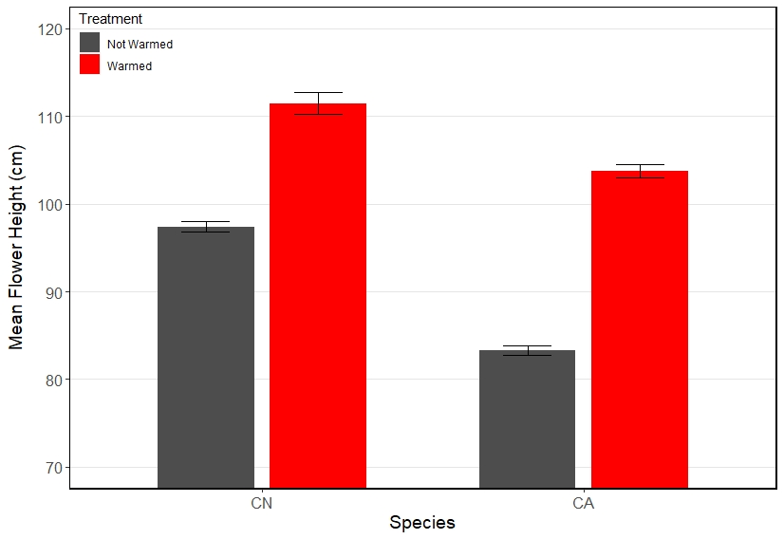
Results
On average, flowers from warmed thistles are taller compared to flowers from unwarmed thistles…
*Error bars represent SEM; t-test used to test significance
Warmed C. nutans flowers are 14.06 cm taller on average.
(df = 1402, p < 0.001)
Warmed C. acanthoides flowers are 20.45 cm taller on average.
(df = 1517, p < 0.001)
C. nutans
C. acanthoides

Slide 48
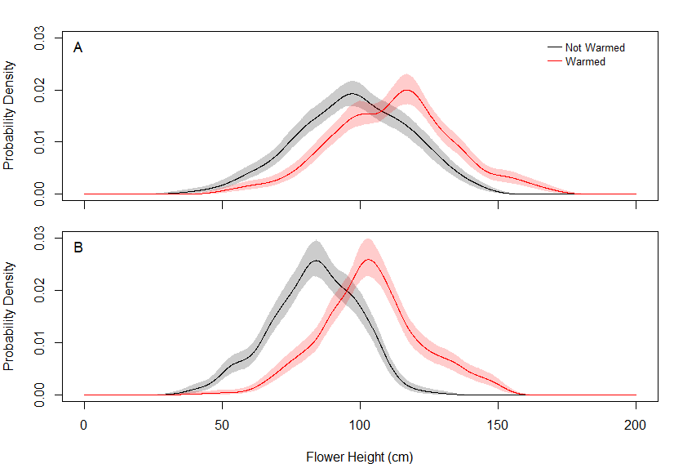
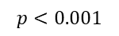
Results
For each species, warming results in a rightward shift in flower height distribution…
*Bands represent 95% bootstrap interval; Kolmogorov-Smirnov test used to test significance
Warmed and unwarmed C. nutans have different height distributions.
Warmed and unwarmed C. acanthoides have different height distributions.
C. nutans
$$p<0.001$$
C. acanthoides
$$p<0.001$$

Slide 49
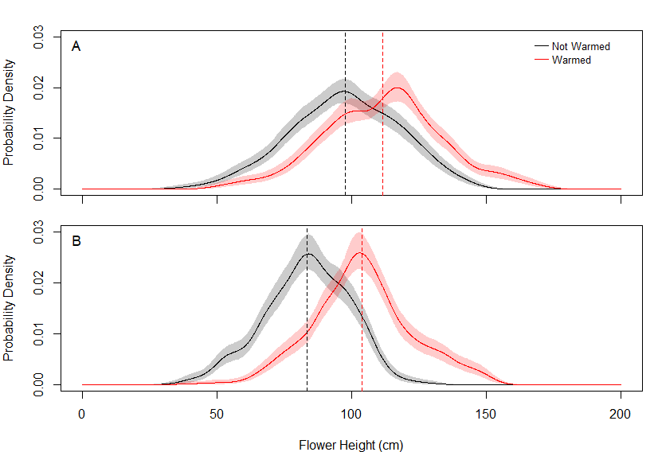
Results
For each species, warming results in a rightward shift in flower height distribution…
*Bands represent 95% bootstrap interval; Kolmogorov-Smirnov test used to test significance
Warmed and unwarmed C. nutans have different height distributions.
Warmed and unwarmed C. acanthoides have different height distributions.
C. nutans
$$p<0.001$$
C. acanthoides
$$p<0.001$$

Slide 50
Results
Research questions
How does increased temperature affect the distribution of flower heights (and thus seed release heights)?
How does increased temperature affect dispersal distances over the distribution of flower heights?
Are there differences in dispersal when using the distribution of seed release heights rather than the maximum height?

Slide 51
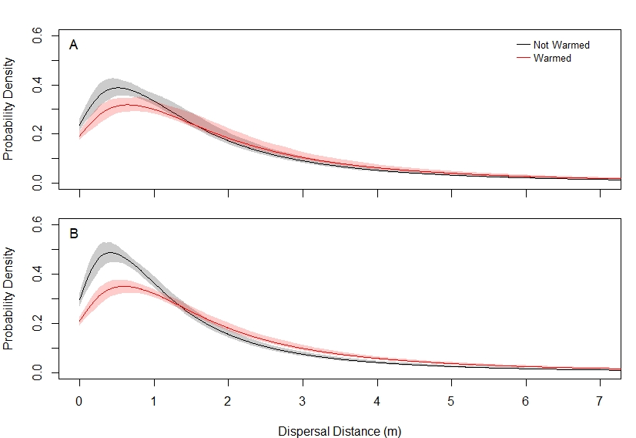
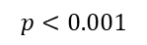
Results
For each species, height changes from warming result in a different dispersal kernel…
*Bands represent 95% bootstrap interval; Kolmogorov-Smirnov test used to test significance
Warmed and unwarmed C. nutans have different dispersal kernels.
Warmed and unwarmed C. acanthoides have different dispersal kernels.
C. nutans
$$p<0.001$$
C. acanthoides
$$p<0.001$$

Slide 52
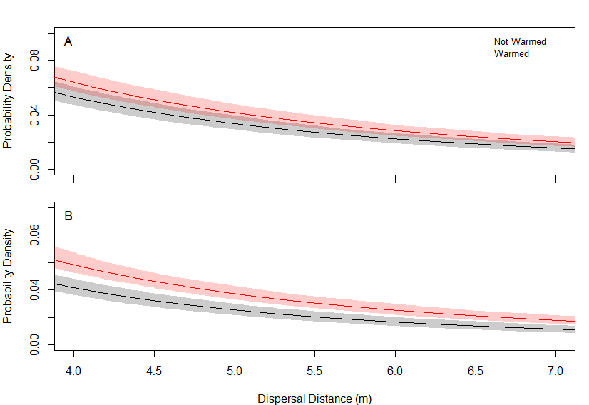
Results
For each species, height changes from warming result in a different dispersal kernel…
*Bands represent 95% bootstrap interval; Kolmogorov-Smirnov test used to test significance
Warmed and unwarmed C. nutans have different dispersal kernels.
Warmed and unwarmed C. acanthoides have different dispersal kernels.
Differences between the kernel tails may appear small, but are actually very important and can have significant impacts…
C. nutans
$$p<0.001$$
C. acanthoides
$$p<0.001$$

Slide 53
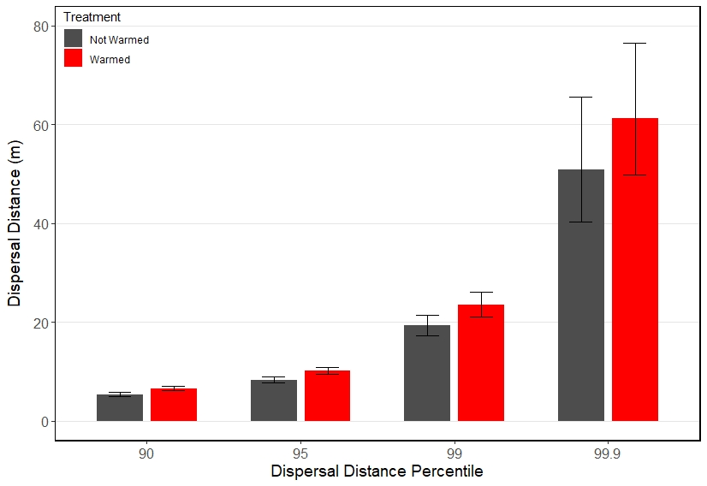
Results
For each species, height changes from warming increase the magnitude of long-distance dispersal events…
*Error bars represent 95% bootstrap interval
C. nutans
For the same high-percentile dispersal distance, seeds from warmed C. nutans travel further.

Slide 54
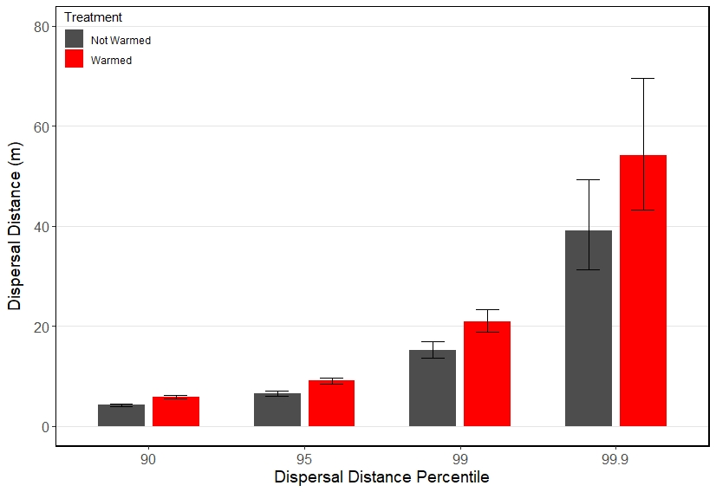
Results
For each species, height changes from warming increase the magnitude of long-distance dispersal events…
*Error bars represent 95% bootstrap interval
C. acanthoides
For the same high-percentile dispersal distance, seeds from warmed C. nutans travel further.
For the same high-percentile dispersal distance, seeds from warmed C. acanthoides travel further.

Slide 55
Results
For each species, height changes from warming increase the magnitude of long-distance dispersal events…
*Error bars represent 95% bootstrap interval
C. acanthoides
For the same high-percentile dispersal distance, seeds from warmed C. nutans travel further.
For the same high-percentile dispersal distance, seeds from warmed C. acanthoides travel further.
Bootstrap intervals inflate for increasingly rare dispersal events.

Slide 56
Results
For each species, height changes from warming increase the magnitude of long-distance dispersal events…
*Error bars represent 95% bootstrap interval
C. nutans
C. acanthoides

Slide 57
Results
Research questions
How does increased temperature affect the distribution of flower heights (and thus seed release heights)?
How does increased temperature affect dispersal distances over the distribution of flower heights?
Are there differences in dispersal when using the distribution of seed release heights rather than the maximum height?

Slide 58
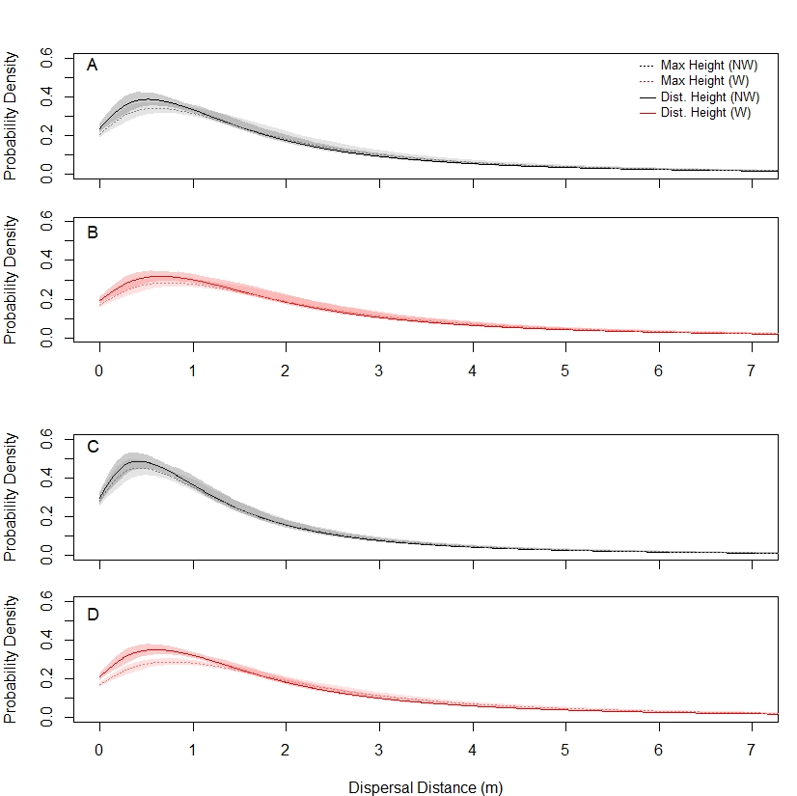
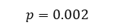
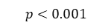
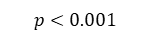
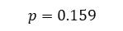
Results
*Bands represent 95% bootstrap interval; Kolmogorov-Smirnov test used to test significance
For each species, using flower height distribution instead of maximum height results in a different dispersal kernel…
For C. nutans, kernels using the height distribution were different than those using the max height for both unwarmed and warmed plants.
C. nutans
$$p=0.002$$
C. nutans
$$p<0.001$$
C. acanthoides
$$p=0.159$$
C. acanthoides
$$p<0.001$$

Slide 59
Results
*Bands represent 95% bootstrap interval; Kolmogorov-Smirnov test used to test significance
For each species, using flower height distribution instead of maximum height results in a different dispersal kernel…
For C. nutans, kernels using the height distribution were different than those using the max height for both unwarmed and warmed plants.
For C. acanthoides, kernels using the height distribution were not different than those using the max height for unwarmed plants, but were for warmed plants.
C. nutans
$$p=0.002$$
C. nutans
$$p<0.001$$
C. acanthoides
$$p=0.159$$
C. acanthoides
$$p<0.001$$

Slide 60
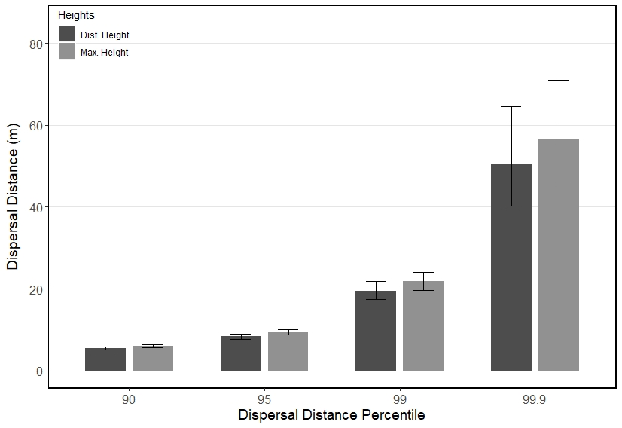
Results
For each species, using the height distribution rather than the max height yields a small decrease in the magnitude of long-distance dispersal events
*Error bars represent 95% bootstrap interval
C. nutans (unwarmed)
For the same high-percentile dispersal distance, seeds from unwarmed C. nutans travel further when using max height rather than height distribution…

Slide 61
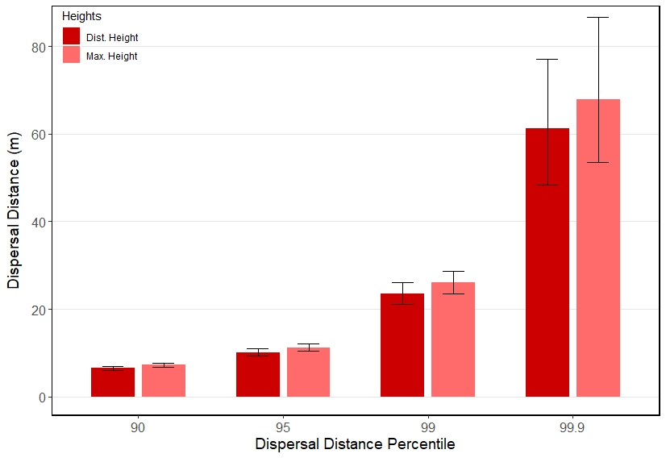
Results
For each species, using the height distribution rather than the max height yields a small decrease in the magnitude of long-distance dispersal events
*Error bars represent 95% bootstrap interval
C. nutans (warmed)
For the same high-percentile dispersal distance, seeds from unwarmed C. nutans travel further when using max height rather than height distribution…
… same for warmed C. nutans.

Slide 62
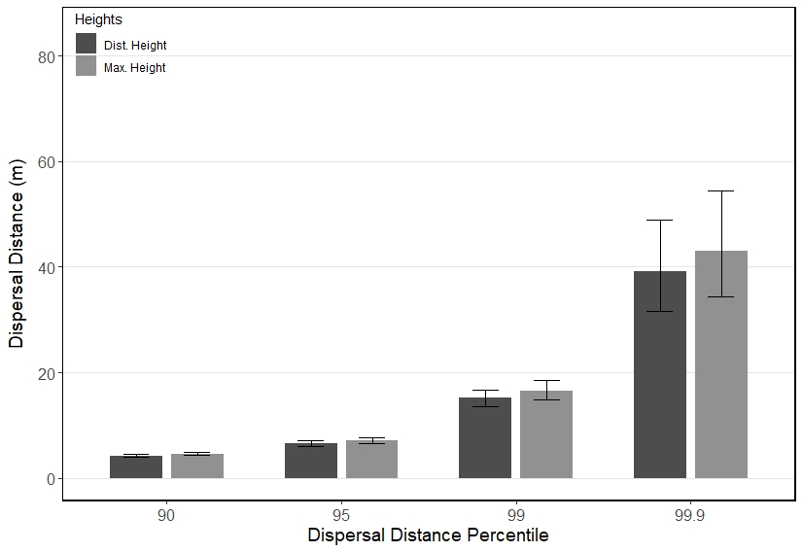
Results
For each species, using the height distribution rather than the max height yields a small decrease in the magnitude of long-distance dispersal events
*Error bars represent 95% bootstrap interval
C. acanthoides (unwarmed)
For the same high-percentile dispersal distance, seeds from unwarmed C. nutans travel further when using max height rather than height distribution…
… same for warmed C. nutans.
… same for unwarmed C. acanthoides.

Slide 63
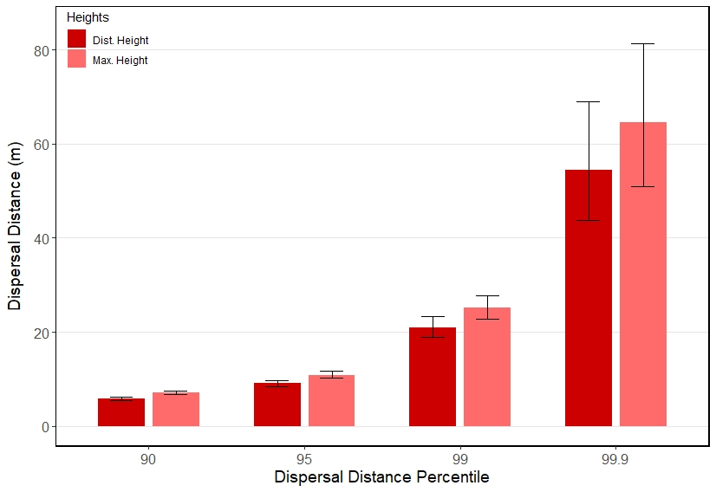
Results
For each species, using the height distribution rather than the max height yields a small decrease in the magnitude of long-distance dispersal events
*Error bars represent 95% bootstrap interval
C. acanthoides (warmed)
For the same high-percentile dispersal distance, seeds from unwarmed C. nutans travel further when using max height rather than height distribution…
… same for warmed C. nutans.
… same for unwarmed C. acanthoides.
… same for warmed C. acanthoides.

Slide 64
Results
For each species, using the height distribution rather than the max height yields a small decrease in the magnitude of long-distance dispersal events
*Error bars represent 95% bootstrap interval
C. acanthoides (warmed)
For the same high-percentile dispersal distance, seeds from unwarmed C. nutans travel further when using max height rather than height distribution…
… same for warmed C. nutans.
… same for unwarmed C. acanthoides.
… same for warmed C. acanthoides.
Again, bootstrap intervals inflate for increasingly rare dispersal events.

Slide 65
Results
For each species, using the height distribution rather than the max height yields a small decrease in the magnitude of long-distance dispersal events
C. nutans (unwarmed)
C. acanthoides (unwarmed)
C. nutans (warmed)
C. acanthoides (warmed)

Slide 66
Discussion & Conclusions
Background & Introduction
Study System & Methods
Image source: O. Skarpaas
Results
Discussion & Conclusions
Image source: brc.ac.uk
Image source: web.ewu.edu

Slide 67
Discussion & Conclusions
How warming affects height…
This is the first study to examine the distributions of seed release heights over the entire plant for C. nutans and C. acanthoides, and how warming affects those distributions.

Slide 68
Discussion & Conclusions
How warming affects height…
This is the first study to examine the distributions of seed release heights over the entire plant for C. nutans and C. acanthoides, and how warming affects those distributions.
Our results show that warming shifts both distributions to the right, increasing seed release heights. Previous studies showed this shift with the maximum flower height; now we show this shift with the entire flower height distribution.

Slide 69
Discussion & Conclusions
… and overall dispersal
As was seen in the previous study, warming changes the dispersal kernel.

Slide 70
Discussion & Conclusions
… and overall dispersal
As was seen in the previous study, warming changes the dispersal kernel.
Here, our results show that even when using the entire height distribution instead of the max height, warming shifts the dispersal kernel to the right and makes the tail “fatter”… dispersal at shorter distances becomes less common, while dispersal at longer distances becomes more common.

Slide 71
Discussion & Conclusions
… and long-distance dispersal
Warming increases the magnitude of long-distance dispersal events.
This increase becomes more pronounced when looking at more rare dispersal events…

Slide 72
Discussion & Conclusions
… and long-distance dispersal
Warming increases the magnitude of long-distance dispersal events.
This increase becomes more pronounced when looking at more rare dispersal events…
… but so does the variation in the magnitude of those more rare events.

Slide 73
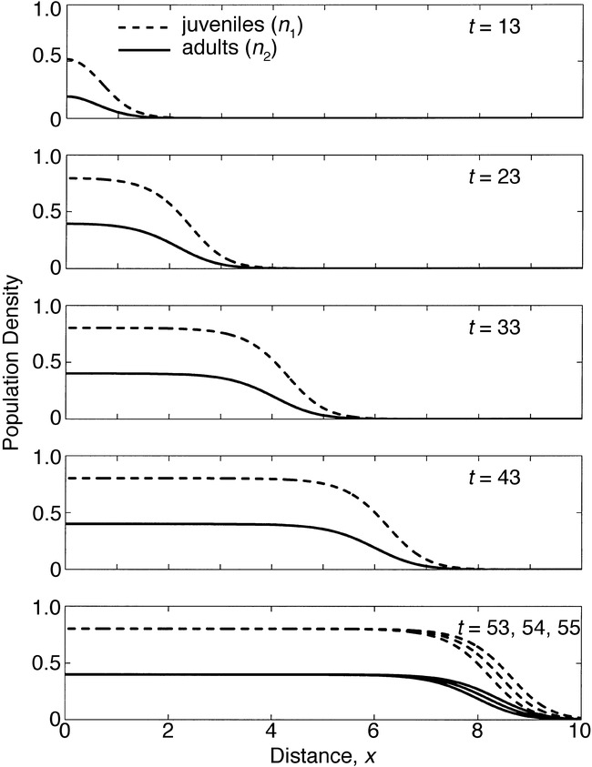
Discussion & Conclusions
… and population spread
Image source: Neubert and Caswell (2000)
These events at the tail end are highly influential in how a population moves across the landscape; models of population spread are often sensitive to these rare events.

Slide 74
Discussion & Conclusions
… and population spread
Image source: Neubert and Caswell (2000)
These events at the tail end are highly influential in how a population moves across the landscape; models of population spread are often sensitive to these rare events.
Thus, warming-induced increases in the magnitude of long-distance dispersal events can increase spread rates. While we have not yet done this with using the entire flower height distribution, increased spread rates have been observed when using max height.

Slide 75
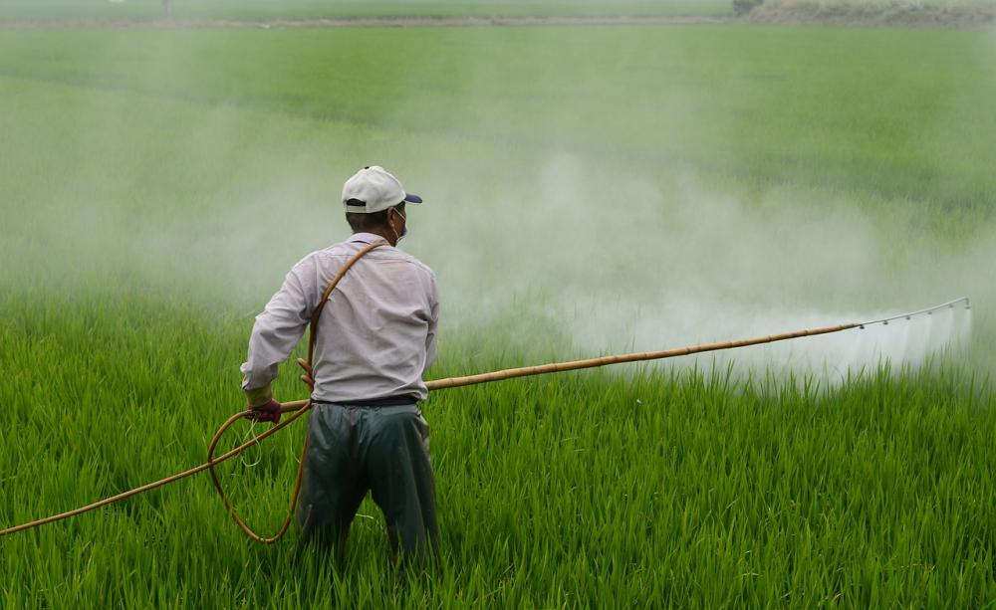
Discussion & Conclusions
Weed management implications
These results have implications for weed management… as warming leads to greater dispersal, the spread of these weeds will be more challenging to control.
Knowing how invasive plants respond to warming can help us continue effective management in future climates.
Image source: Pixabay

Slide 76
Discussion & Conclusions
Dream big… but start small
Temperature increases
For now, we’ve started with a model examining effects of temperature increase on dispersal.
Precipitation shifts
Changes in wind speeds
Increased frequency of extreme events

Slide 77
Discussion & Conclusions
Dream big… but start small
Temperature increases
For now, we’ve started with a model examining effects of temperature increase on dispersal.
In future work, we plan to examine effects of changes in wind speed as well…
Precipitation shifts
Changes in wind speeds
Increased frequency of extreme events

Slide 78
Discussion & Conclusions
Dream big… but start small
Temperature increases
For now, we’ve started with a model examining effects of temperature increase on dispersal.
In future work, we plan to examine effects of changes in wind speed as well…
… and perhaps the effects of shifts in other climate-related variables.
Precipitation shifts
Changes in wind speeds
Increased frequency of extreme events

Slide 79
Discussion & Conclusions
Dream big… but start small
Temperature increases
For now, we’ve started with a model examining effects of temperature increase on dispersal.
In future work, we plan to examine effects of changes in wind speed as well…
… and perhaps the effects of shifts in other climate-related variables.
Progress begins with a step in the right direction.
Precipitation shifts
Changes in wind speeds
Increased frequency of extreme events

Slide 80
References
Beaury, E.M., Fusco, E.J., Jackson, M.R., Laginhas, B.B., Morelli, T.L., Allen, J.M., Pasquarella, V.J. and Bradley, B.A. 2020. Incorporating climate change into invasive species management: insights from managers. Biological Invasions, 22(2), pp.233-252.
Katul, G.G., Porporato, A., Nathan, R., Siqueira, M., Soons, M.B., Poggi, D., Horn, H.S. and Levin, S.A., 2005. Mechanistic analytical models for long-distance seed dispersal by wind. The American Naturalist, 166(3), pp.368-381.
Neubert, M.G. and Caswell, H., 2000. Demography and dispersal: calculation and sensitivity analysis of invasion speed for structured populations. Ecology, 81(6), pp.1613-1628.
Skarpaas, O. and Shea, K., 2007. Dispersal patterns, dispersal mechanisms, and invasion wave speeds for invasive thistles. The American Naturalist, 170(3), pp.421-430.
Zhang, R., Jongejans, E. and Shea, K., 2011. Warming increases the spread of an invasive thistle. PLoS One, 6(6).

Slide 81
Questions?
Ask them in-call
Post them in the chat
Email them to me at thd5066@psu.edu
Image source: O. Skarpaas
Many thanks to the Shea Lab for providing resources, guidance, and feedback!

